Slide 1
Human Capital: Digital inclusion and skills

Slide 2
For the Human Capital dimension of the Digital Economy and Society Index (DESI), the highest scores were achieved by Finland, Sweden, the United Kingdom and Luxembourg. Romania, Bulgaria, Greece, Cyprus and Italy had the lowest scores.
Indicators included in the Human Capital dimension of the DESI 2016
The Human Capital dimension covers (a) ‘basic skills and usage’ and (b) ‘advanced skills and development’. ‘Basic skills and usage’ comprises indicators of whether people use the internet and of whether they have basic digital skills. ‘Advanced skills and development’ comprises indicators on ICT specialist employment and on graduates in STEM (science, technology and mathematics). LU, DK, FI, NL and SE score highest for basic skills and usage, while FI, SE, the UK and IE score best for advanced skills and development. RO, BU, EL, CY and IT rank lowest overall on the Human Capital dimension.
 | EU 28
2a1 Internet Users % individuals (aged 16-74) | 76% (2015)
2a2 Basic Digital Skills % individuals (aged 16-74) | 55% (2015)
2b1 ICT Specialists % employed individuals | 3.7% (2014)
2b2 STEM Graduates Graduates in STEM per 1000 individuals (aged 20 to 29) | 18 (2013)
Europe's Digital Progress Report 2016 – Digital inclusion and skills

Slide 3
76 % of EU citizens go online weekly, and 67 % daily. 63 % of disadvantaged people use the internet weekly. The old (53 %) and low educated (55 %) are furthest behind.
The percentage of internet users in the population continues to increase; 76 % of the EU population use the internet at least weekly (2015). For most people, internet use is a daily activity: 67 % of EU citizens reported using it daily in 2015. Use by disadvantaged people also rose to 63 % in 2015. These rates are higher than the targets for this year in the Digital Agenda, which were already reached last year. While the steady increase in regular internet use is positive, based on past trends we can still only expect regular use by 90 % of the population by 2024.
Among different categories of disadvantaged people, while the unemployed have a rate of internet use similar to that of the EU average, the rates for the older population (53 %), the low educated (55 %) and the retired or inactive (49 %) remains around 20 percentage points or more lower. In particular, age and education levels are strong determinants of internet usage. Digital inclusion policies should focus on these groups.

Slide 4
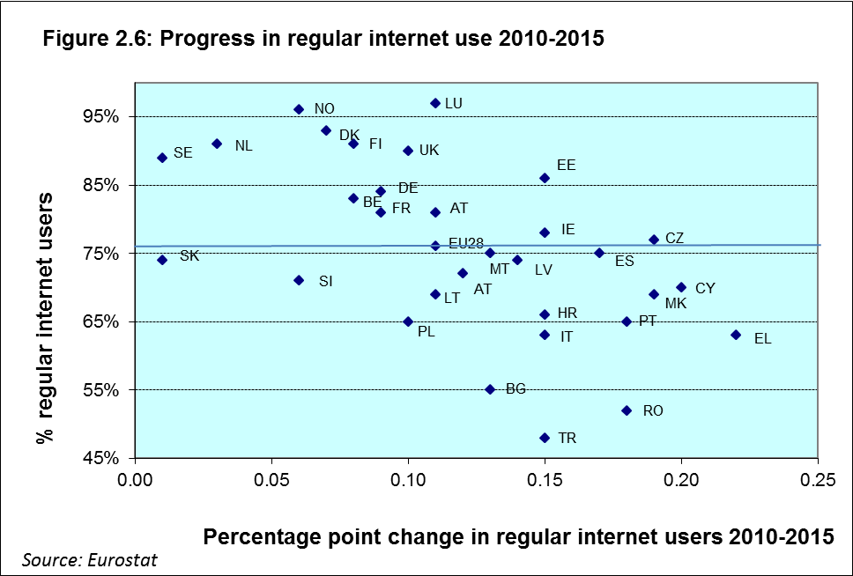
Rates of weekly internet use across the EU Member States remain quite dispersed, but there has been significant catch-up over time.
Across Europe, rates of weekly internet use remain dispersed and the rankings of countries with the highest and lowest rates have changed very little over time. The highest rates of weekly internet use are found in the Nordic countries, Luxembourg, the Netherlands and the United Kingdom, where rates are around 90 % or more. At the other end of the scale, in countries with the lowest rates of weekly internet use in the EU(RO, BG), around half of the population does not use the internet on a weekly basis.
Nevertheless, there has also been significant catch-up with, generally speaking, larger increases in the rates of weekly use in countries with the most catching up to do. In particular, from 2010 to 2015 regular use of internet by Greek citizens rose by over 20 percentage points. Cyprus, the Czech Republic, Portugal, Romania and the Former Republic of Macedonia have also seen similar rises. Other lagging countries such as Spain, Italy and Croatia have also made significant improvements. All of these countries now have rates above 60 %. While figures for Romania (+18 percentage points) and Bulgaria (+13 percentage points) have also risen, their very low starting position mean that they remain substantially below the EU average.

Slide 5
The number of non-internet users continues its gradual downward trend and big improvements have been made in some countries with large rates of non-users. However 16 % of the EU population has still never used the internet.
In the EU, the share of non-internet users in total population fell marginally in 2015, to 16 % from 18 % a year earlier. Nearly all Member States made some improvement in reducing rates of non-users. The biggest improvements were made in Romania (-7 percentage points) and Italy (-4 percentage points). Above average reductions were also made in Greece, Portugal, Malta and Estonia (-3 percentage points each). Taking a longer view, Romania (-25 percentage points) and Greece (-23 percentage points) are the countries that have made the most progress in reducing non-use of the internet by their citizens over the past 5 years; followed by Cyprus (-19 percentage points), Portugal (-18 percentage points), Bulgaria (-17 percentage points) and Croatia (-16 percentage points). However, a number of countries still need to do more to reduce their relatively high shares of non-internet users in total population. Furthermore, Slovenia (22 %; -6 percentage points) and Poland (27 %; -8 percentage points) stand out in 2015 as countries with above average rates of non-users and relatively slow progress in reducing them since 2010.

Slide 6
The biggest barriers to internet access at home in the EU are lack of need, insufficient skills and cost barriers. In particular, lack of skills has increased in importance as a reason over time.
The most important reasons for households not having internet access are that it is not needed (46 %), they lack the skills (41 %) or the equipment (27 %) or access (23 %) costs are too high. In particular, lack of skills has gained substantially in importance over time (+9 percentage points since 2010). Lack of need has also increased as a reason but has declined somewhat since 2013. While a relatively less cited reason, concerns about privacy and security (+3 percentage points since 2010) have also risen.
Looking at different household types, cost factors are substantially more important reasons for not having internet access at home among households with children (61 %) and those on low incomes (42 %).

Slide 7
In 2015 45 % of the EU population had an insufficient level of digital skills. 21 % had none at all, as they did not use the internet.
According to the Digital Skills Indicator*, a composite indicator based on the EU digital competence framework for citizens**, 21 % of the EU population can be considered as having no digital skills (2015) as they are not using the internet. This figure ranges from 3 % in Luxembourg to 44 % in Bulgaria and Romania. In eight countries (PT, PL, HR, CY, IT, EL, BG and RO) 30 % or more of the population have no digital skills. In Italy, with its large population, this equates to almost 18 million people without digital skills; in Poland it means around 12 million.
Considering that to function effectively in a digital society an individual needs more than low level skills (e.g. only being able to send emails)***, 45 % of the EU population can be considered as insufficiently digitally skilled (having either low or no digital skills or not using the internet). Seventeen Member States have rates higher than this. In Romania (74 %) most of the population does not have the skills they need to function effectively in the digital world.
* http://ec.europa.eu/newsroom/dae/document.cfm?action=display& doc_id=9979 .
** EU Digital Competence framework for citizens (DigComp) was developed by the Joint Research Centre’s Institute for Prospective Technologies Studies on behalf of DG Employment, Social Affairs and Inclusion. For more information, see https://ec.europa.eu/jrc/en/digcomp/.
*** A ‘low skilled’ individual is someone who has carried out activities from only one of the four digital competence domains included in the index (information, communication, content creation or problem-solving). To qualify as having ‘basic skills’, an individual has to have ‘basic skills’ in at least one domain, and ‘no use’ in none. To be classified ‘above basic’, the individual has to score above basic in each of the four domains.

Slide 8
In 2015 37 % of the EU labour force had an insufficient level of digital skills.13 % had no digital skills at all, as they did not use the internet.
Rates of digital skills among the labour force are on average higher than for the average population in the EU. Only 13 % of the EU labour force has no digital skills (most not using the internet). However, in some Member States rates are still relatively high. In seven countries (EL, CY, PL, PT, IT, BG and RO) rates are at or above 20 % of the labour force. In Romania and Bulgaria more than a third of the labour force has no digital skills.
If we also add to this the percentage of the labour force who have only a low level of skill, 37 % of the EU labour force can be considered to be insufficiently digitally skilled. In 15 Member States (FR, SI, ES, HR, HU, LT, LV, EL, PT, IT, IE, PL, CY, BG and RO) the percentage is higher. In Bulgaria (64 %) and Romania (70 %) it is most of the labour force.

Slide 9
Internet users in the EU most lack the digital skills needed to use basic software tools which are increasingly seen as indispensable in the workplace and beyond
Among the four digital competence domains assessed in the digital skills indicator*, internet users in the EU most lack the digital skills needed to create and manipulate commonly used basic software tools. While only 6 % of internet users in the EU report not having carried out any of the commination or information activities and only 10 % any of the problem-solving tasks, 26 % have not used any of the more common basic software for the manipulation of text, data, photos or videos. This group of internet users, ranging from 9 % (LU) to 49 % (RO), it can be considered, are at an increasing disadvantage in the labour market, as more and more jobs require these types of skills.
*These are: information, communication, software, and problem-solving (the fifth domain, security, is not assessed, for lack of suitable indicators). In each domain, a set of activities is used to determine whether individuals have the skills or do not have the skills and in some cases (where information is available on the variety or complexity of the task) whether the level of skills is ‘above average’.
Digital skills in the EU by digital competence domain, 2015
(% of internet users)
Source: Commission services based on Eurostat data
Software skills of internet users in the EU, 2015

Slide 10
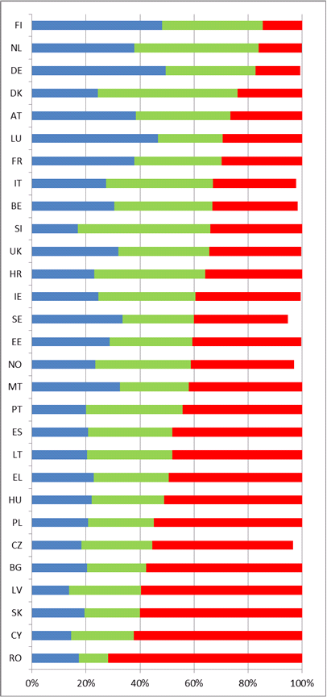
EU digital citizens are not always able to protect themselves, their data and their privacy.
Security and privacy skills (knowledge and management of cookies) of internet users, 2015
Cookies are largely used by almost all web-services with different purposes, but still more than one third of European internet users (35 %) do not know they can be used to trace their online movements.
Among the remaining, more aware, internet users, only half has taken action to prevent or limit cookies by changing browser parameters.
There seems to be greatest awareness in countries with more advanced and longer use of ICT technologies. There are some national particularities, like Germans being very protective of their privacy, and DK, SI and NL internet users, despite different degrees of awareness, taking little action against cookies.

Slide 11
Over the last decade, employment of ICT specialists has grown by 2.9 million in the EU. By contrast, total employment has not improved and has been falling since the onset of the crisis in 2008.
Over the period 2004-2014* employment of ICT specialists in the EU-28 grew significantly by 2.9 million; from around 5.1 million in 2004 to 8 million in 2014. This resulted in an increase in the share of ICT employment in total employment from 2.5 % to 3.7 %. ICT employment growth averaged over 4 % a year (allowing for the break in the series in 2010-2011). By contrast, the average growth rate of total employment was 0.4 % a year. Overall employment fell almost continuously following the onset of the economic and financial crisis in 2008 and has only begun to increase once more since 2014.**
All EU countries have seen a big increase in ICT specialist employment in the last 10 years. The largest employment gains were made in the big Member States, DE (765 000), FR (417 000), ES (269 000), PL (182 000) and the UK (162 000).
*Since this period included the break in series due to the update of ISCO to its latest version, the figures referring to the dynamics of ICT specialists’ employment need to be interpreted with caution.
**http://ec.europa.eu/eurostat/statistics-explained/index.php/File:Employment_rate,_age_group_15 %E2 %80 %9364,_2004 %E2 %80 %9314_(%25)_YB16.png.
However, growth in ICT specialist employment has been very substantial in many smaller countries. The Member States with the highest rates of ICT specialist employment in total employment are FI (6.7 %), SE (6 %), LU (5 %), NL (5 %), EE (5 %) and the UK (4.9 %).
The UK employs the largest number of ICT specialists in absolute terms (1.49 million); however, Germany is rapidly catching up (1.47 million), having doubled its ICT employment in the last 10 years. The biggest employment gains have been made outside the ICT sector and in the ICT services sector.

Slide 12
The EU has a growing deficit of ICT professional skills, forecast to reach 756 000 by 2020.
Despite the strong rise in employment of ICT professionals in the EU over the past decade, the employment potential of ICT is underexploited. Evidence shows that there is a growing gap emerging between the demand for and supply of ICT specialists in Europe. The latest forecasts suggest the gap could double over the next five years: from 373 000 in 2015 to 756 000 by 2020.*
Currently the largest ICT professional skills gap is to be found in Germany, followed by the UK and France. These skills gaps are expected to grow substantially up to 2020, especially in the UK, Germany, Italy and France; largely due to insufficient production of ICT graduates to keep up with strongly increasing demand for ICT professionals in these countries.
*http://eskills-lead.eu/fileadmin/LEAD/Working_Paper_-_Supply_demand_forecast_2015_a.pdf
E-Skills Vacancies Estimate – Main forecast scenario:
Distribution of vacancies per country ('000s)
Source: Empirica (November 2015)

Slide 13
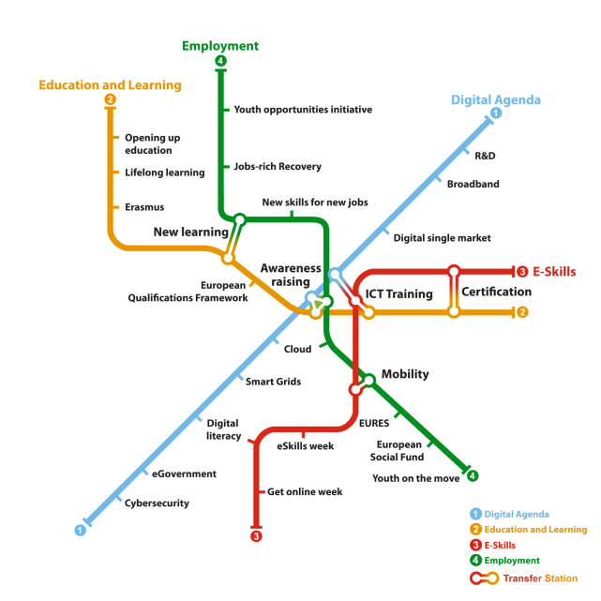
The Commission's Grand Coalition for Digital Jobs initiative and the 13 national coalitions have led to the training of an estimated over 2 million people since the initiative's launch in 2013.
The European Commission is addressing lacking digital skills in Europe with its Grand Coalition for Digital Jobs initiative.* This multi-stakeholder initiative has so far attracted around 60 pledges, from over 100 stakeholders, to undertake concrete actions to reduce digital skills gaps in Europe. Actions are grouped around five themes: training and matching for digital jobs (29), certification (6), innovative learning and teaching (11), mobility (1) and awareness raising (12). It has also lead to the setting of national coalitions in 13 countries (BE, BG, CY, EL, IT, LT, LU, LV, MT, PL, PT, RO, UK), with more to come. There are also active local coalitions in a number of regions around Europe.
*https://ec.europa.eu/digital-single-market/en/grand-coalition-digital-jobs
To help set up national and local coalitions in the EU Member States, the Commission has produced a ‘toolkit’ providing useful information and outlining the essential ingredients for a successful coalition.**
It is estimated that these actions and initiatives have led to the training of over 2 million people in digital skills since the launch of the coalition in 2013. Ongoing and recent new pledges and initiatives will lead to the training of millions more. Progress on the pledges of the Grand Coalition is self-reported by pledgers on the Grand Coalition Pledge Tracker.***
**https://ec.europa.eu/digital-single-market/sites/digital-agenda/files/toolkit_for_national_and_local_coalitions_5.pdf
***http://www.linkedpolicies.eu/pledge/

